Slide 1

W
E
L
C
O
M
E
DR. THITIYA DISPHANURAT
EMAIL : THITIYADSP@AU.EDU
Office : SM340
MS Team chat

Slide 2
Course Description:
Teachings of major world religions, the role of conscience, self-development in the moral arena, building self-esteem, self-knowledge, and good habits, distinguishing the right from the wrong, doing the right and refraining from the wrong, attaining a more fulfilling life, civil right and duties.

Slide 3
Mark Allocation

Slide 4
Participation (10%)
Students are required to have 80% attendance. You can have at most 6- class absences for the entire semester. Those having many absences beyond the limit will be called for warning, and debarment (auto “W” grade) is applied before the final exam.
ATTENDANCE / PARTICIPATION CHECK DURING CLASS HOURS

Slide 5


AU dress code
Dress code for attending class and obtaining class attendance To obtain permission to attend classes and be granted class attendances, undergraduate students are obligated to strictly comply with permissible classroom entry time stipulated in the provided course syllabus as well as the university dress codes. Ref: Assumption University of Thailand Regulations of Uniform and Dress Code for Day Program Students, issued on January 22, 2021 (https://sa.au.edu/)

Slide 6
On Campus Activites (20%)
Bro.Amnuay visit and sharing
GE spotlight exhibition / booth on Feb
AU Chapel tour on Dec
Details will be discussed later
All students must be a part of these activities.

Slide 7
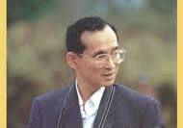
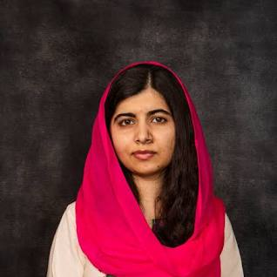
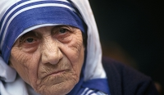
Topics are about great people and moral stories:
Required reading
(10%) - teamwork
- King Rama 9
- Malala
- Mother Teresa
Four wives
** Soft files in AULMS and MS TEAM are given for your choice.

Slide 8
A booth/exhibition for GE spotlight activity in CL plaza
Project (15%)
teamwork
*Further to be discussed
*To be implemented on February 2024

Slide 9
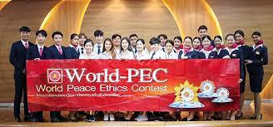
World Peace Ethics contest
-- Application by yourself
-- Own choice (not mandatory)
-- Prizes / Cash

Slide 10



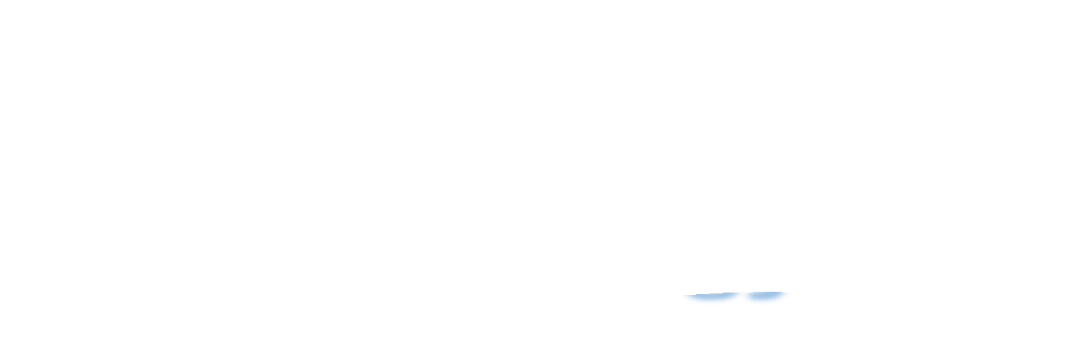
TEXTBOOKS
Amnuay Y. (2021). Becoming a new person.
Slides on MS Team>>Files

Slide 11

Where can I the textbook?
MS team channel or AULMS
Files to be downloadable Both the text and slides

Slide 12

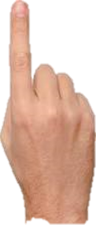
PART I: MAJOR WORLD RELIGIONS
Before
Midterm
chapters
PART II: ETHICS AND CONSCIENCE
REQUIRED READING PRESENTATION
AU chapel Tour

Slide 13
PART III: WORLD ISSUES
Final
PART IV: THE ASIAN ISSUES
Chapters
PART V: THAI ISSUES
Project work
GE spotlight booth
PART VI: BECOMING A NEW PERSON

